Slide 1
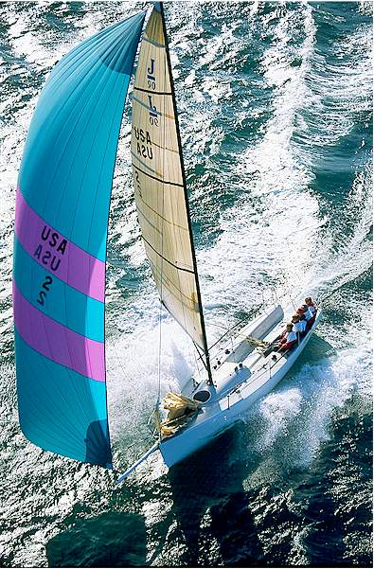
Learning To Sail

Slide 2
What Are We Doing Today?
Wind
  Direction
  Puffs and Lulls
Determining the Status of a Boat
  What Tack?
  What Point of Sail?
Skipper Postition and Steering
Trimming the Sails
Tacking and Jibing

Slide 3
Wind
Where is the wind coming from?
  Waves are often perpendicular
How strong is the wind?
  Puff - Increase in wind strength
    Normally darker water
    Water looks “busier”
  Lull - Decrease in wind strength
    Normally lighter water
    Water looks flatter

Slide 4
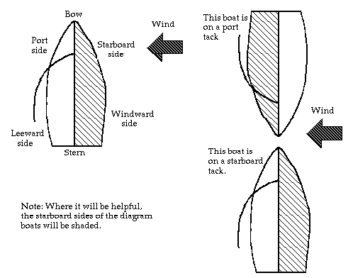
What Tack?
Starboard Tack
Port Tack

Slide 5
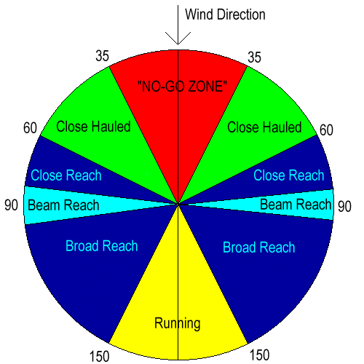
What is the Point of Sail?
Starboard Tack
Port Tack

Slide 6
Skipper Position and Steering
Where do you sit?
  Skipper - Windward side of the boat
    Provides better visibility
    Generally balances the boat better
  Crew - Wherever needed
How do you steer?
    When going forward - push the tiller away from the direction you want to turn.
    When going backward - push the tiller the direction you want to go.

Slide 7
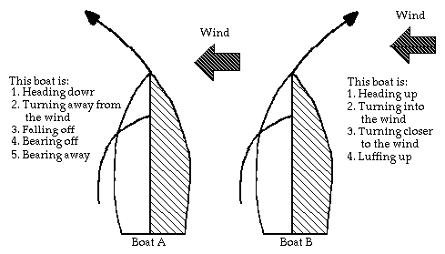
Skipper Position and Steering
Important terms in steering

Slide 8
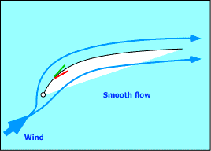
Trimming the Sails
Upwind
  Sails act like a wing
  Sails pull the boat along
Lift

Slide 9
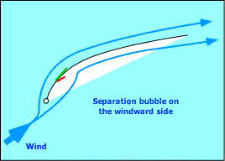
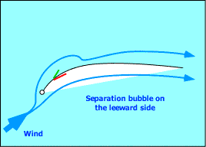
Trimming the Sails
Luffing
  Inside telltale falls
  Sheet In
  Fall Off, Head Down
Too Tight
  Outside telltale falls
  Sheet Out
  Head Up

Slide 10
Trimming the Sails
Downwind
  Sails act like a parachute
  Sails grab the air and are pushed along
  Telltales don’t work
Based on Wind Speed
  Light Air - Fat and powered up
  Heavy Air - Flat and tight, depowered

Slide 11
Tacking and Jibing
Tacking
  It is how you get straight upwind
  Turning the bow of the boat through the wind
Jibing
  It is how you can get straight downwind
  Turning the stern of the boat through the wind

Slide 12
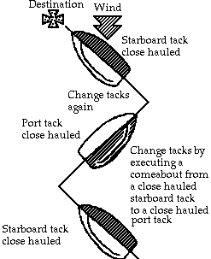
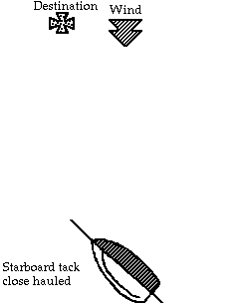
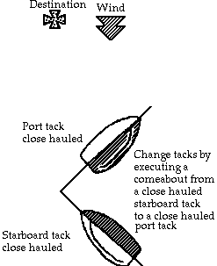
Tacking and Jibing
Tacking

Slide 13
Tacking and Jibing
Tacking

Slide 14
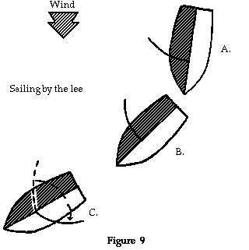
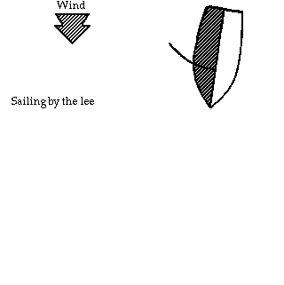
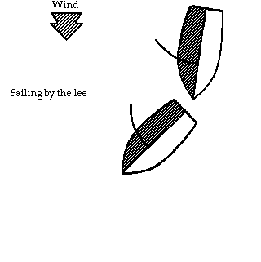
Tacking and Jibing
Jibing

Slide 15
Tacking and Jibing
Jibing

Slide 16
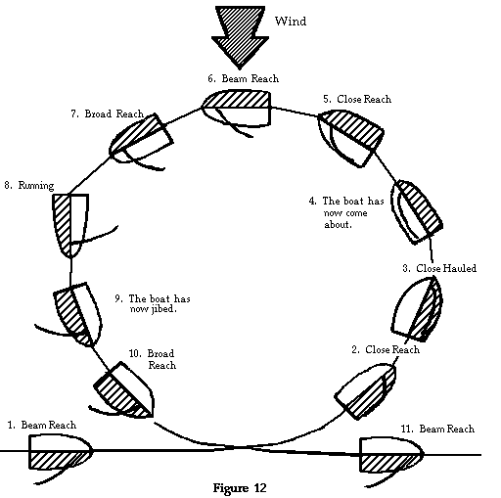
Tacking and Jibing
Demonstration

Slide 17
Anything Else?

